Slide 1
JEREMIAH

Slide 2
JEREMIAH
Jeremiah ~ The Lord has appointed

Slide 3
JEREMIAH
Backsliding ~ 13x

Slide 4
JEREMIAH
Jeremiah’s ministry
640 BC
620 BC
600 BC
580 BC
Josiah 640-609 BC
Jehoahaz 609 BC (3 months)
Jehoakim 609 -598 BC
Jehoiachin 598 BC (3 months)
Zedekiah 598 586 BC
Jeremiah’s ministry 626 - 586 BC
The Kings of Jeremiah

Slide 5
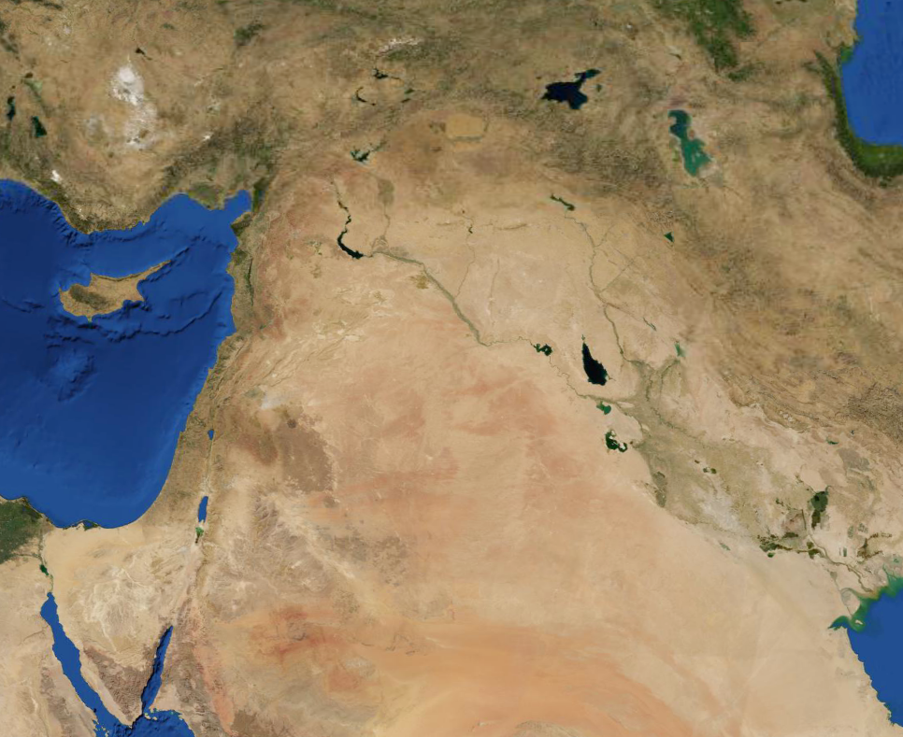
JEREMIAH
Carchemish
Babylonians
Egyptians
Battle of Carchemish

Slide 6
JEREMIAH
Jeremiah’s ministry
640 BC
620 BC
600 BC
580 BC
1st Deportation (605 BC)
2nd Deportation (597 BC)
3rd Deportation (586 BC)
The 3 Deportations of Judah

Slide 7
JEREMIAH
Jeremiah “Wordle”

Slide 8
JEREMIAH
The Lord our righteousness ~ YHWH Tsidkenu

Slide 9
JEREMIAH
But the hour is coming, and now is, when the true worshipers will worship the Father in spirit and truth; for the Father is seeking such to worship Him.
John 4.23

